Slide 1
2
DERIVATIVES

Slide 2
2.1
Derivatives and Rates of Change

Slide 3
Derivatives and Rates of Change
The problem of finding the tangent line to a curve and the problem of finding the velocity of an object involve finding the same type of limit, which we call a derivative.

Slide 4
The Tangent Problem

Slide 5
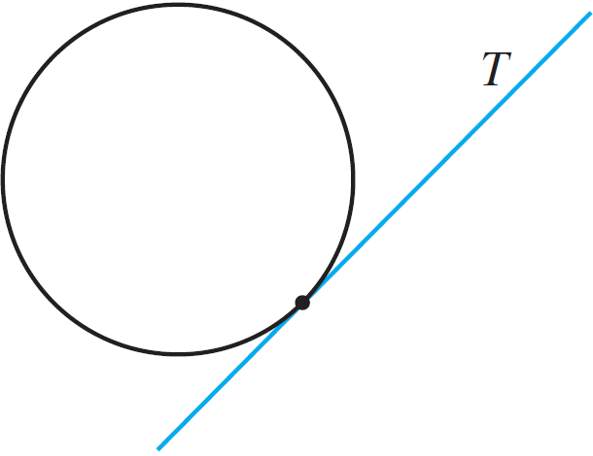
The Tangent Problem
The word tangent is derived from the Latin word tangens, which means “touching.”
Thus a tangent to a curve is a line that touches the curve.
For a circle we could simply follow Euclid and say that a tangent is a line that intersects the circle once and only once as in Figure 1(a).
Figure 1 (a)

Slide 6
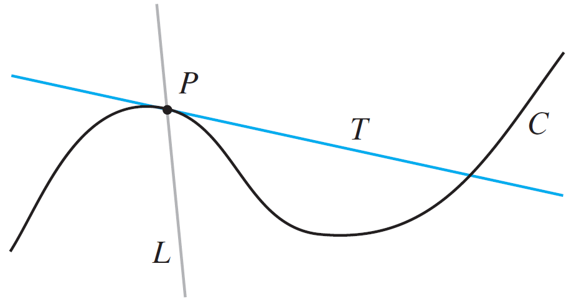
The Tangent Problem
For more complicated curves this definition is inadequate. Figure 1(b) shows two lines L and T passing through a point P on a curve C.
Figure 1 (b)

Slide 7
The Tangent Problem
The line L intersects C only once, but it certainly does not look like what we think of as a tangent.
The line T, on the other hand, looks like a tangent but it intersects C twice.

Slide 8
Example 1
Find an equation of the tangent line to the parabola y = x ² the point P (1, 1).
SOLUTION:
We will be able to find an equation of the tangent line T as soon as we know its slope m.
The difficulty is that we know only one point, P, on T, whereas we need two points to compute the slope.

Slide 9
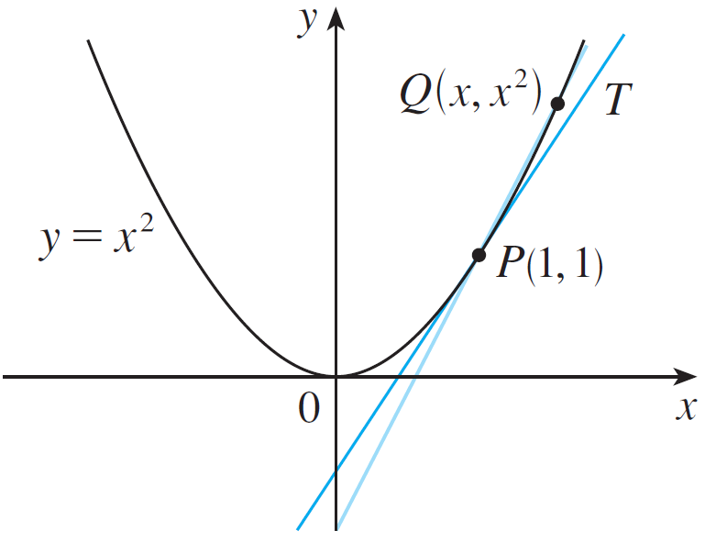
Example 1 – Solution
cont’d
But observe that we can compute an approximation to m by choosing a nearby point Q (x, x ²) on the parabola (as in Figure 2) and computing the slope of m_{PQ} of the secant line PQ. [A secant line, from the Latin word secans, meaning cutting, is a line that cuts (intersects) a curve more than
once.]
Figure 2

Slide 10
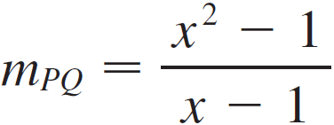
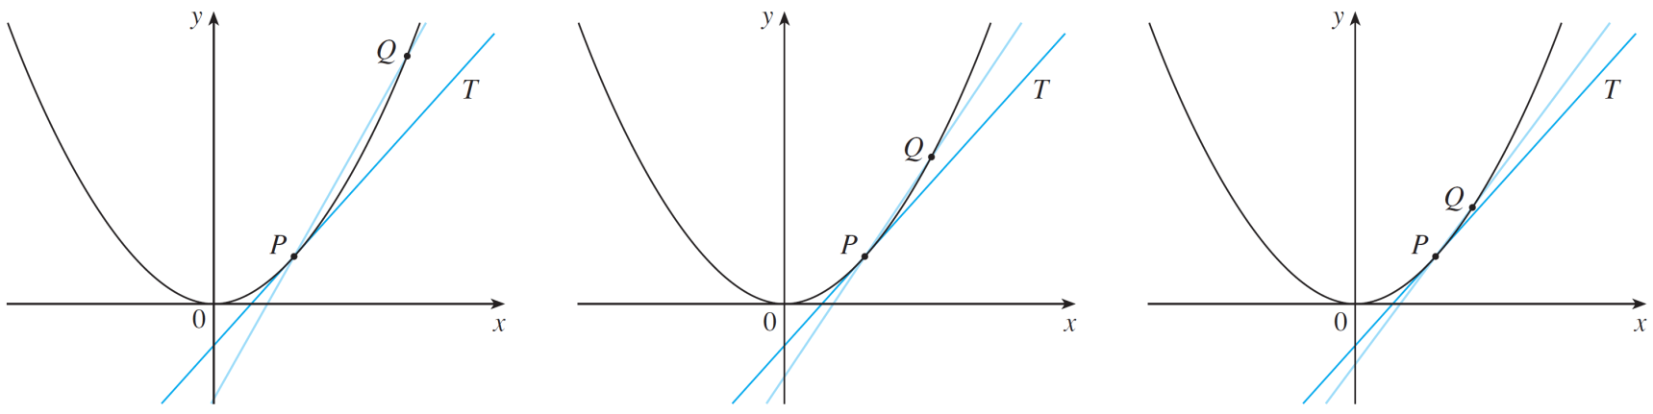
Example 1 – Solution
cont’d
We choose x ≠ 1 so that Q ≠ P. Then
What happens as x approaches 1? From Figure 3 we see that Q approaches P along the parabola and the secant lines PQ rotate about P and approach the tangent line T.
Q approaches P from the right
Figure 3

Slide 11
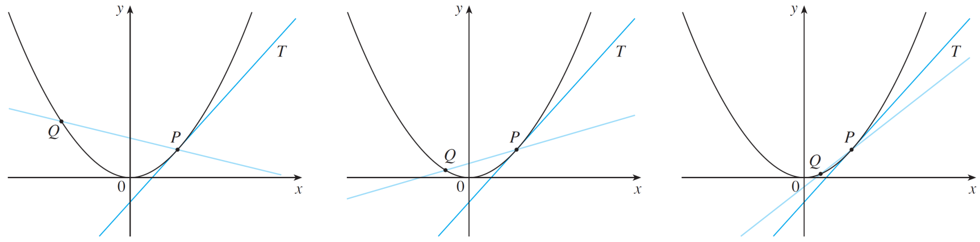
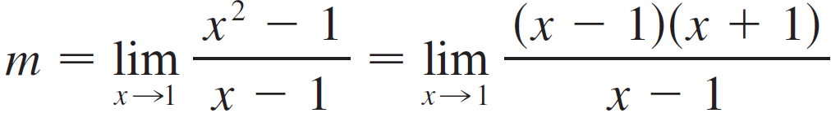
Example 1 – Solution
cont’d
It appears that the slope m of the tangent line is the limit of the slopes of the secant lines as x approaches 1:
Q approaches P from the left
Figure 3

Slide 12

Example 1 – Solution
cont’d
Using the point-slope form of the equation of a line, we find that an equation of the tangent line at (1, 1) is

Slide 13
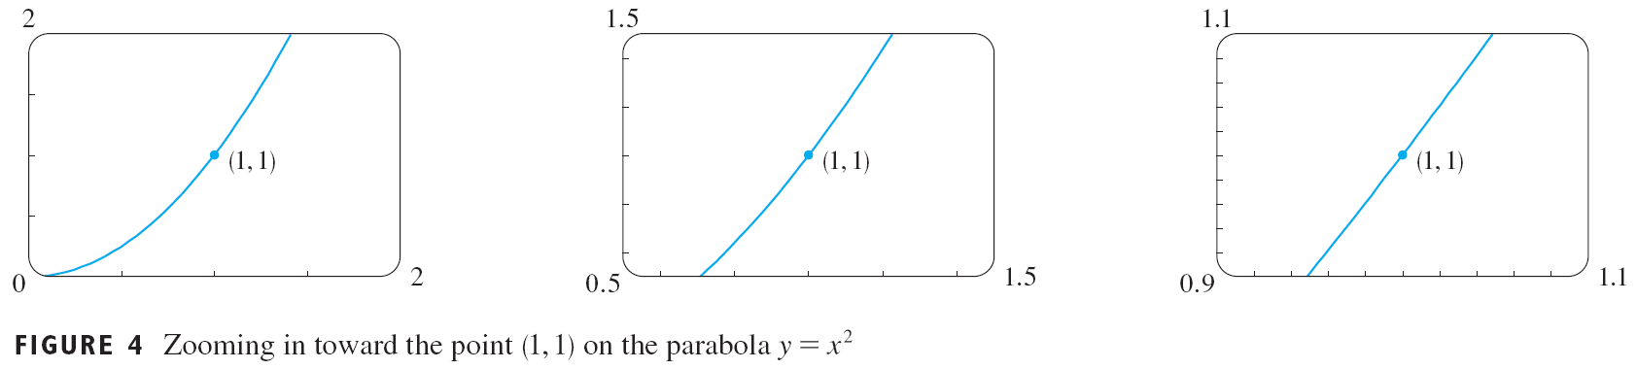
The Tangent Problem
We sometimes refer to the slope of the tangent line to a curve at a point as the slope of the curve at the point.
The idea is that if we zoom in far enough toward the point, the curve looks almost like a straight line.

Slide 14
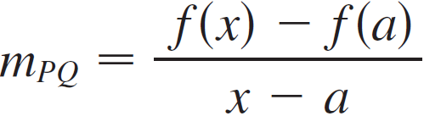
The Tangent Problem
In general, if a curve C has equation y = f (x) and we want to find the tangent line to C at the point P(a, f (a)), then we consider a nearby point Q(x, f (x)), where x ≠ a, and compute the slope of the secant line PQ:

Slide 15
The Tangent Problem
Then we let Q approach P along the curve C by letting x approach a. If m_{PQ} approaches a number m, then we define the tangent T to be the line through P with slope m. (This amounts to saying that the tangent line is the limiting position of the secant line PQ as Q approaches P. See Figure 5.)
Figure 5

Slide 16
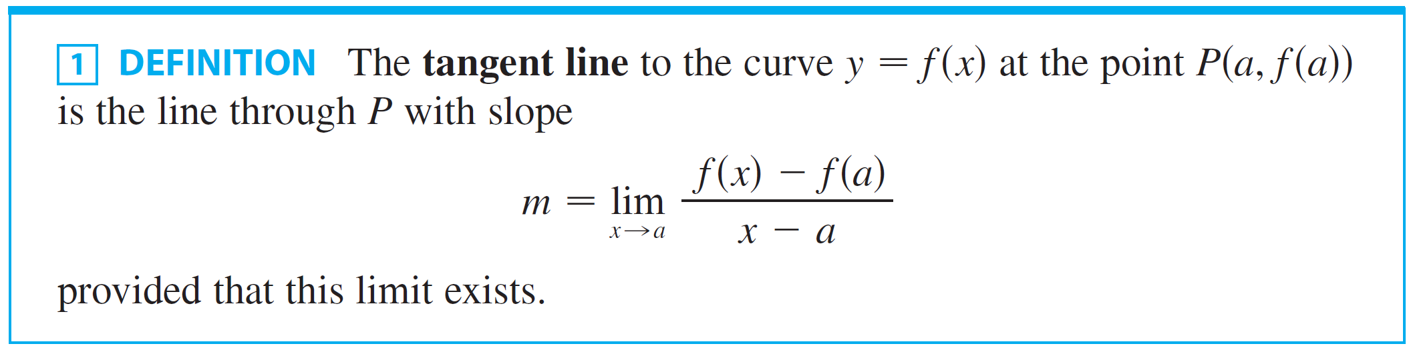
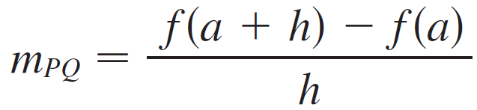
The Tangent Problem
There is another expression for the slope of a tangent line that is sometimes easier to use. If h = x – a, then x = a + h and so the slope of the secant line PQ is

Slide 17
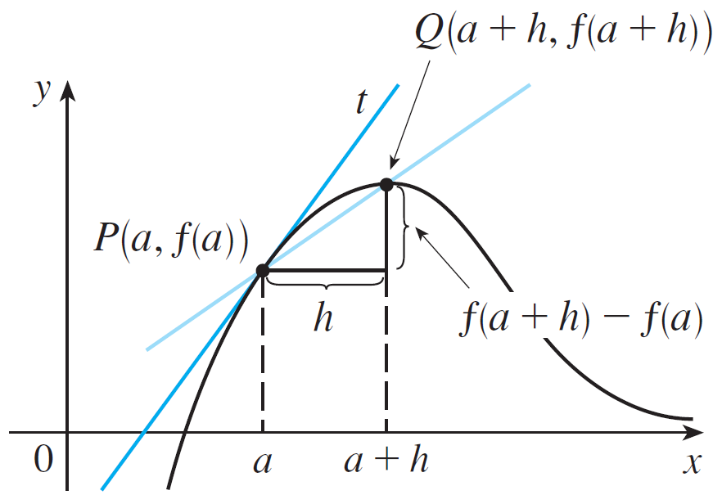
The Tangent Problem
(See Figure 6 where the case h > 0 is illustrated and Q is to the right of P. If it happened that h < 0, however, Q would be to the left of P.)
Figure 6

Slide 18
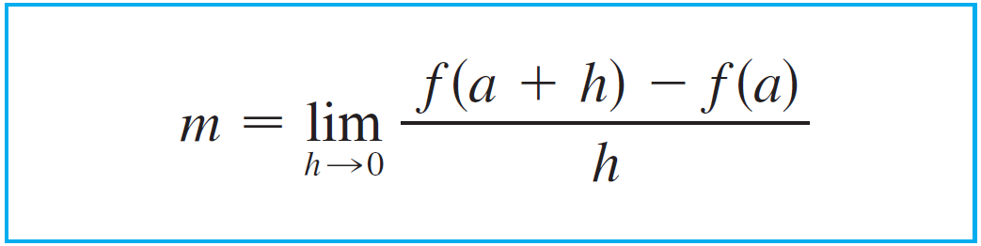

The Tangent Problem
Notice that as x approaches a, h approaches 0 (because h = x – a) and so the expression for the slope of the tangent line in Definition 1 becomes

Slide 19
Example 2
Find an equation of the tangent line to the hyperbola y = 3/x at the point (3, 1).
SOLUTION:
Let f(x) = 3/x
Then, the slope of the tangent at (3, 1) is

Slide 20
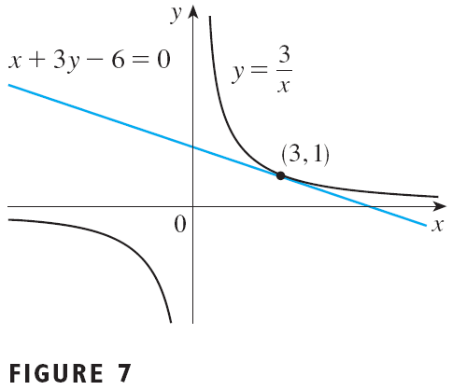
Example 2 SOLUTION
Therefore, an equation of the tangent at the point (3, 1) is
This simplifies to x + 3y – 6 = 0
The hyperbola and its tangent are shown in Figure 7.

Slide 21
The Velocity Problem

Slide 22
The Velocity Problem
Suppose an object moves along a straight line according to an equation of motion s = f (t), where s is the displacement (directed distance) of the object from the origin at time t.
The function f that describes the motion is called the position function of the object.
In the time interval from t = a to t = a + h the change in position is f (a + h) – f (a).

Slide 23
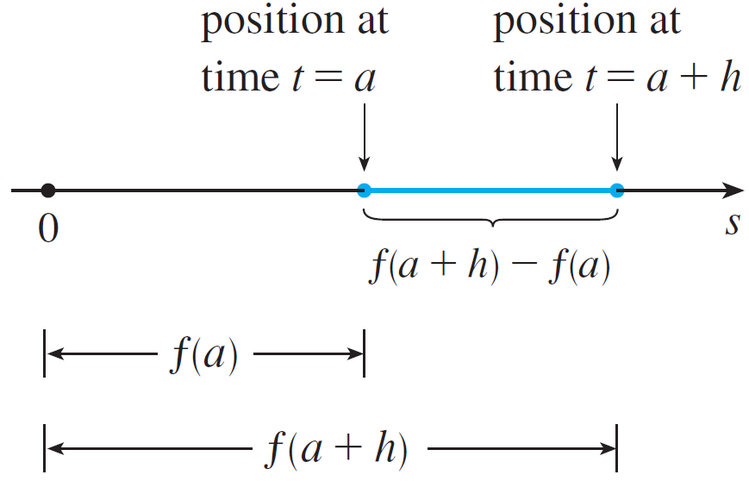
The Velocity Problem
See Figure 8.
Figure 8

Slide 24
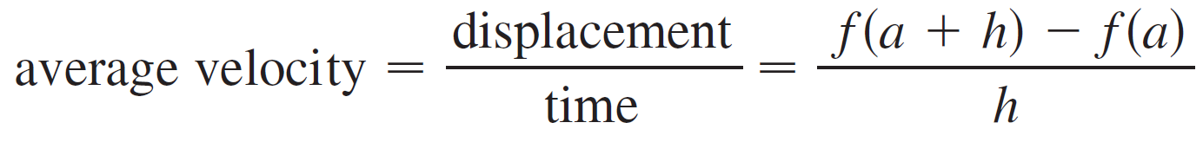
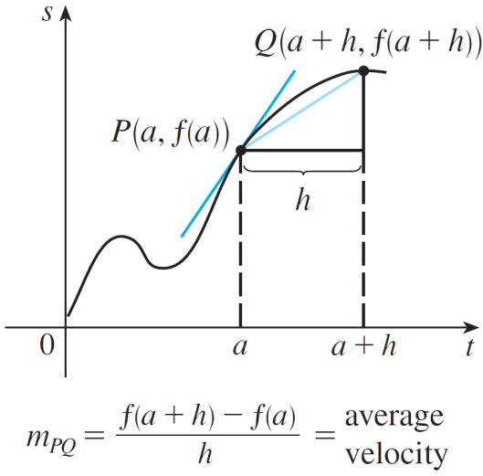
The Velocity Problem
The average velocity over this time interval is
which is the same as the slope of the secant line PQ in Figure 9.
Figure 9

Slide 25
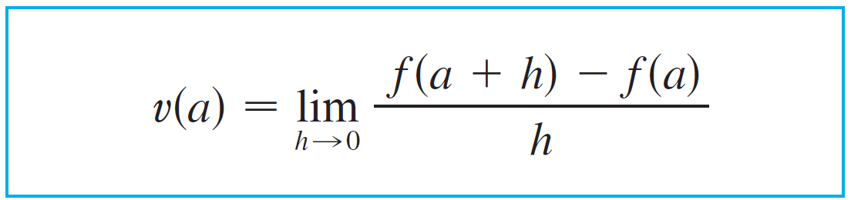

The Velocity Problem
Now suppose we compute the average velocities over shorter and shorter time intervals [a, a + h]. In other words, we let h approach 0.
We have defined the velocity (or instantaneous velocity) v(a) at time t = a to be the limit of these average velocities:

Slide 26
The Velocity Problem
This means that the velocity at time t = a is equal to the slope of the tangent line at P (compare Equations 2 and 3).

Slide 27
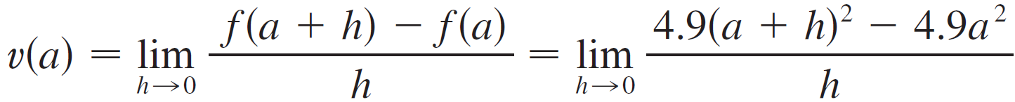
Example 3
Suppose that a ball is dropped from the upper observation deck of the CN Tower, 450 m above the ground.
(a) What is the velocity of the ball after 5 seconds?
(b) How fast is the ball traveling when it hits the ground?
SOLUTION:
We first use the equation of motion s = f (t ) = 4.9t ² to find the velocity v (a ) after a seconds:

Slide 28
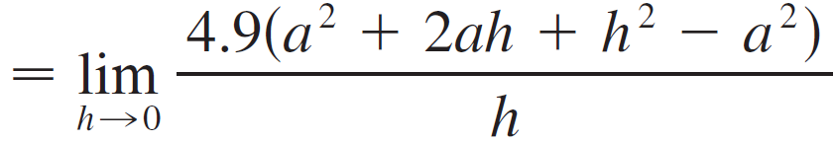
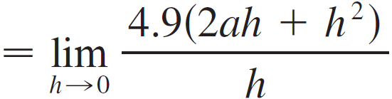


Example 3 – Solution
cont’d
(a) The velocity after 5 s is .

Slide 29

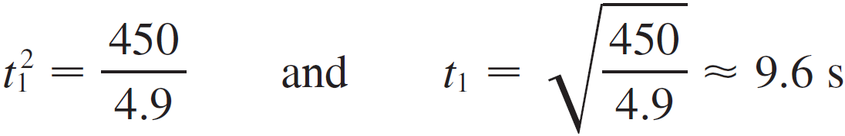
Example 3 – Solution
cont’d
(b) Since the observation deck is 450 m above the ground, the ball will hit the ground at the time t₁ when s (t₁) = 450, that is,
This gives

Slide 30
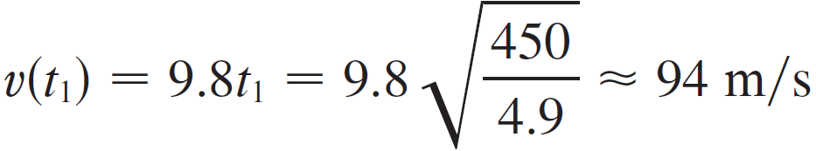
Example 3 – Solution
cont’d
The velocity of the ball as it hits the ground is therefore

Slide 31
Derivatives

Slide 32
DERIVATIVES
We have seen that the same type of limit arises in finding the slope of a tangent line (Equation 2) or the velocity of an object (Equation 3).
In fact, limits of the form arise whenever we calculate a rate of change in any of the sciences or engineering, such as a rate of reaction in chemistry or a marginal cost in economics.
Since this type of limit occurs so widely, it is given a special name and notation.

Slide 33
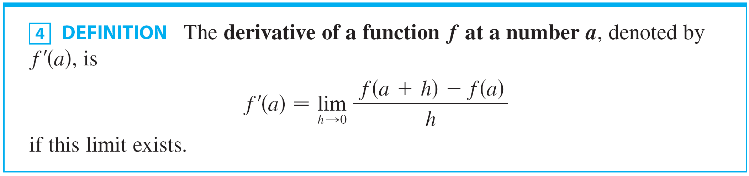
Derivatives
If we write x = a + h, then h = x – a and h approaches 0 if and only if x approaches a.

Slide 34
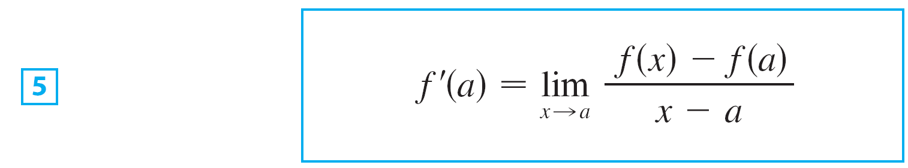
Derivatives
Therefore an equivalent way of stating the definition of the derivative, as we saw in finding tangent lines, is

Slide 35

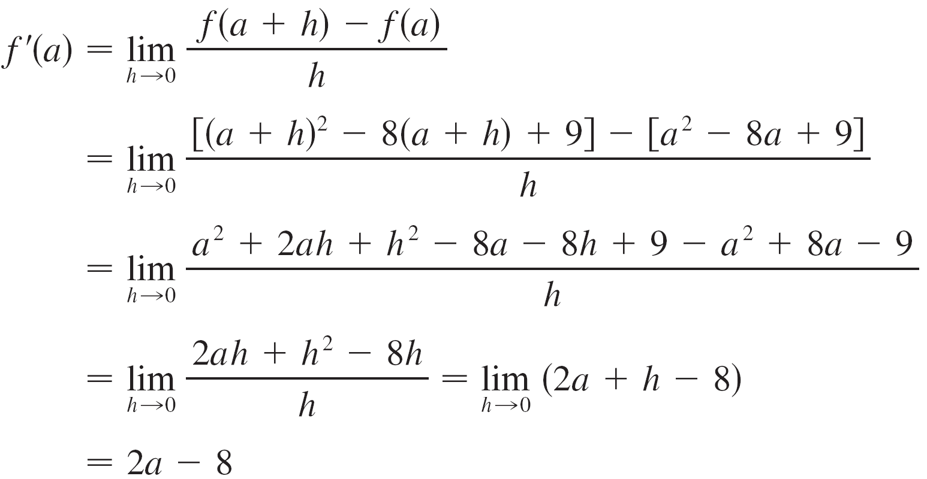
Example 4
Find the derivative of the function at the number a.
SOLUTION: From Definition 4 we have

Slide 36
Example 4 – Solution
cont’d

Slide 37
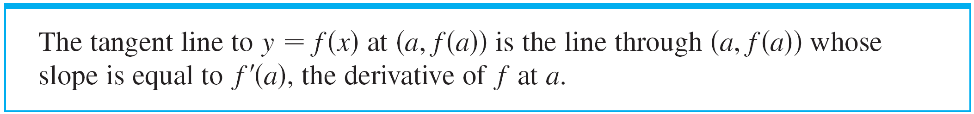

Derivatives
If we use the point-slope form of the equation of a line, we can write an equation of the tangent line to the curve y = f (x) at the point (a, f (a)):

Slide 38
Example 5
Find an equation of the tangent line to the parabola y = x² – 8x + 9 at the point (3, – 6).
SOLUTION:
From Example 4, we know that the derivative of f(x) = x² – 8x + 9 at the number a is f’(a) = 2a – 8.
Therefore, the slope of the tangent line at (3, – 6) is f’(3) = 2(3) – 8 = – 2.

Slide 39
Example 5 SOLUTION
Thus, an equation of the tangent line, shown in Figure is y – (– 6) = (– 2)(x – 3) or y = – 2x

Slide 40
Rates of Change

Slide 41


Rates of Change
Suppose y is a quantity that depends on another quantity x. Thus y is a function of x and we write y = f (x).
If x changes from x₁ to x₂, then the change in x (also called the increment of x ) is
and the corresponding change in y is

Slide 42
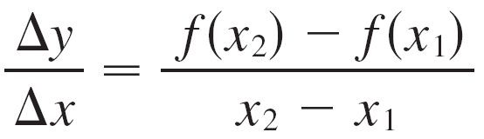
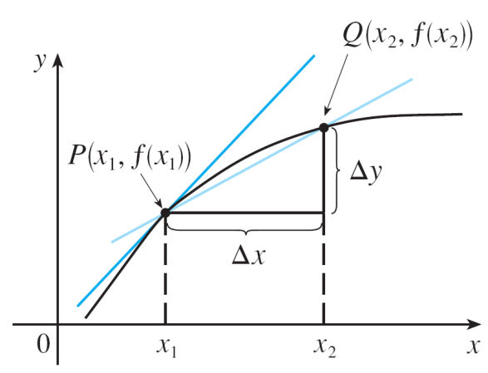
Rates of Change
The difference quotient
is called the average rate of change of y with respect to x over the interval [x₁, x₂] and can be interpreted as the slope of the secant line PQ in Figure 11.
average rate of change = m_{PQ} instantaneous rate of change = slope of tangent at P
Figure 11

Slide 43

Rates of Change
By analogy with velocity, we consider the average rate of change over smaller and smaller intervals by letting x₂ approach x₁ and therefore letting Δx approach 0.
The limit of these average rates of change is called the (instantaneous) rate of change of y with respect to x at x = x₁, which is interpreted as the slope of the tangent to the curve y = f (x) at P(x₁, f (x₁)):

Slide 44

Rates of Change
We know that one interpretation of the derivative f ′(a ) is as the slope of the tangent line to the curve y = f (x ) when x = a.
We now have a second interpretation:

Slide 45
RATES OF CHANGE
The connection with the first interpretation is that, if we sketch the curve y = f(x), then the instantaneous rate of change is the slope of the tangent to this curve at the point where x = a.

Slide 46
RATES OF CHANGE
This means that
When the derivative is large (and therefore the curve is steep, as at the point P in Figure 12), the y-values change rapidly.
When the derivative is small, the curve is relatively flat and the y-values change slowly.
In particular, if s = f (t ) is the position function of a particle that moves along a straight line, then f ′(a ) is the rate of change of the displacement s with respect to the time t.

Slide 47

Rates of Change
In other words, f ′(a ) is the velocity of the particle at time t = a. The speed of the particle is the absolute value of the velocity, that is,
In the next example we estimate the rate of change of the national debt with respect to time.
Here the function is defined not by a formula but by a table of values.

Slide 48
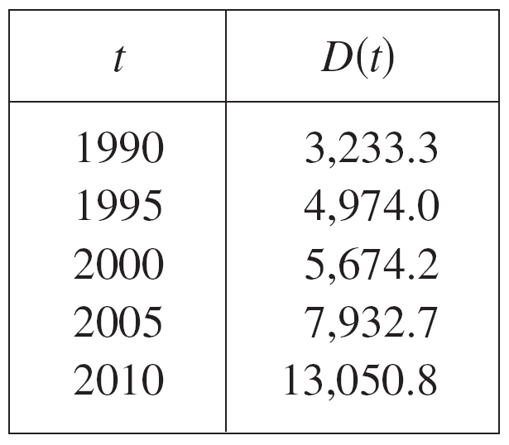
Example 6
Let D(t) be the US national debt at time t. The table below gives approximate values of this function by providing end of year estimates, in billions of dollars, from 1990 to 2010. Interpret and estimate the value of D′(2000).

Slide 49
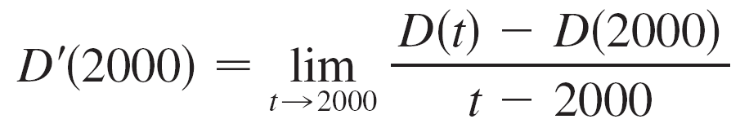
Example 6 – Solution
The derivative D′(2000) means the rate of change of D with respect to t when t = 2000, that is, the rate of increase of the national debt in 2000.
According to Equation 5,

Slide 50
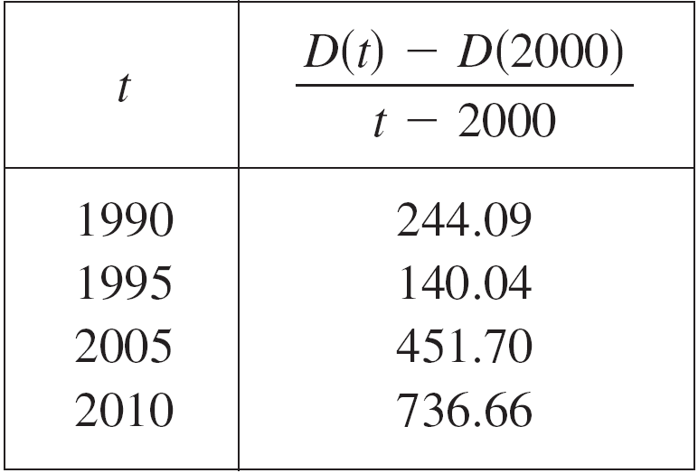
Example 6 – Solution
cont’d
So we compute and tabulate values of the difference quotient (the average rates of change) as follows.
From this table we see that D′(2000) lies somewhere between 140.04 and 451.70 billion dollars per year. [Here we are making the reasonable assumption that the debt didn’t fluctuate wildly between 1995 and 2005.]

Slide 51
Example 6 – Solution
cont’d
We estimate that the rate of increase of the national debt of the United States in 2000 was the average of these two numbers, namely
D′(2000) ≈ 296 billion dollars per year
Another method would be to plot the debt function and estimate the slope of the tangent line when t = 2000.

